Slide 1
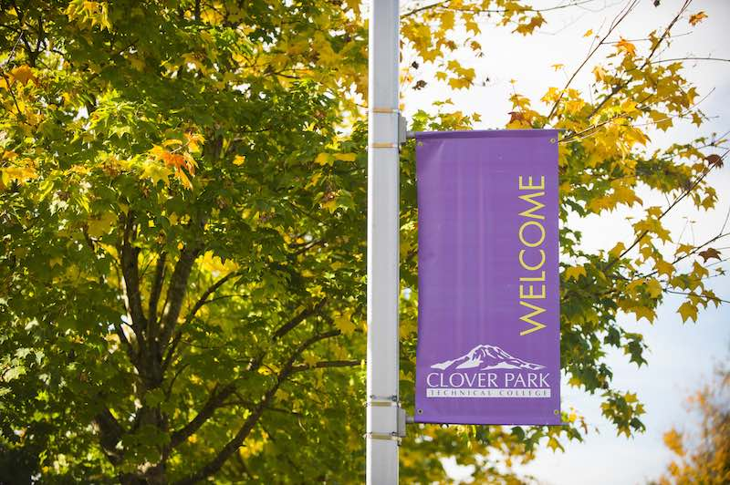
Proposed Revisions
To the Governing Documents of the Associated Students

Slide 2
Agenda
Statement of the problem
Project overview
Summary of changes
Work accomplished to date
Timeline
Public comment
What you can do

Slide 3
Statement of the Problem
Consistent turnover of Student Government members
Decline in engagement amongst student and college constituents
Student employees from other areas of the department have stepped in to ensure continuity of student governance
Continuing to operate this cycle will produce same outcomes
A student engagement and leadership development pilot project was launched Fall 2019 with the aim of developing an innovative and sustainable approach to student governance based on the unique characteristics of college students who attend a technical college.

Slide 4
Project Overview
Guiding principles of the project were:
Continuity of governance
Cultivating student voice
Dynamic team development
Developing an action oriented approach
Flexibility and fluidity of roles
Cultivating leaders
Remaining relevant as a student association
Developing cross-campus connections
During the pilot project, selections & appointments (Article V) and membership (Article I) were modified to reflect the egalitarian, committee chair structure that is being proposed.

Slide 5
Summary of Changes
Updates to filling Student Government chair vacancies as they occur during academic year through appointment of vice chair or either conducting a hiring process (Sept. 1 – Jan. 31) or interim appointment (Feb. 1 – May 31).
Shift from a hierarchical, top-down structure to an egalitarian-style organization where members share equal responsibility and power
Titles of five committee members align with strategic initiatives of student association and college priorities
Grammar, spelling and punctuation revisions
Housekeeping revisions

Slide 6
Work Accomplished to Date
2020 Initial edits to governing documents were discussed in early 2020 and then project was “paused” until Fall Quarter 2020 due to COVID-19.
January – February (2021) Student led constitution and by-laws revision committee meets regularly during winter quarter to discuss and review proposed changes
March Proposed changes submitted to Student Government at March 16 meeting
April Website about proposed changes launched and email to students about proposed changes sent to all CPTC students and college administration n

Slide 7
Timeline
The Student Government will review the proposed changes and feedback at business meetings on April 21, May 5 and May 19
All current students are invited to review the proposed changes and ask comments and questions
Student-led committee will incorporate any feedback and make the updated and final document available no later than May 20
Student Government will ratify proposed changes at June 2 meeting

Slide 8
Public Comment
Throughout spring quarter, CPTC students are invited to attend a regularly scheduled Student Government business meeting and ask a question or make a comment about the proposed changes on the following Wednesdays at 3:30p.
April 21
May 5
May 19
Joining the meeting details are available at www.cptc.edu/asg
If you don’t have time to attend a meeting, fill out a comment card before May 19 at 12:00p and your comment and/or question will be shared during the business meeting. To get started, please visit www.cptc.edu/asg-proposed-revisions.

Slide 9
Why Seek Student Feedback?
It is important that CPTC students have a voice and opportunity to provide input on policy and procedure changes that impact them
Student governance relies on student voice and involvement of students in the process. Your voice, your choice!
Aligns with College’s shared governance model which is a set of practices that provide college stakeholders an opportunity to be informed and have input into decisions that affect them

Slide 10
Appeal the Amendment
Pursuant to Article XIV – Amendments of the ASCPTC Constitution & By-Laws, students may appeal the amendment by submitting a petition to Student Government in accordance with Article XI: Initiative before ratification can take effect.
To learn more about how any CPTC student may initiate an article of legislation, including a petition to appeal the proposed changes, please review the ASCPTC Constitution & By-Laws which is available at www.cptc.edu/asg-proposed-revisions

Slide 11
Thank You!
Your assistance getting more information and asking clarifying questions will help improve the governing documents of the Associated Students.
If ratified, it will mean a more innovative and forward-thinking student governance structure.
If you need more info about this process, please contact:
Cal Erwin-Svoboda Associate Dean for Student Success cal.erwin@cptc.edu 253-589-5644
Find out more at www.cptc.edu/asg-proposed-revisions

